Slide 1

School Management System
COIT20272
Presentation by:
Hiththetiyage group

Slide 2

Group Members:
Hiththetiyage Don Danul Hivi Vihan (12262853)
Dulmini Kalupahana (12270912)
Jaymeen Vaghela (12263274)
Shoeb Sohail Khan (12254683)

Slide 3


Project Background
Traditional school management relies heavily on manual processes, leading to inefficiencies.
Teachers, students, and administrators face communication gaps and data management challenges.
Need for a centralized digital system to manage timetables, learning materials, and notifications.
Aim to improve accessibility, automation, and collaboration in school operations.
Prototype developed using Python, MySQL, FastAPI, and React Native to ensure scalability and usability

Slide 4

Project Objectives
Provide a centralized platform for administrators, teachers, and students.
Automate key tasks like timetables, notifications, and learning material sharing.
Enhance communication and collaboration within the school community.
Ensure secure user access with role-based authentication (admin/teacher/student).
Deliver a scalable, user-friendly system accessible via web and mobile devices.
Support data-driven decision-making with integrated reporting and AI features.
Track progress using GitHub and Jira.

Slide 5
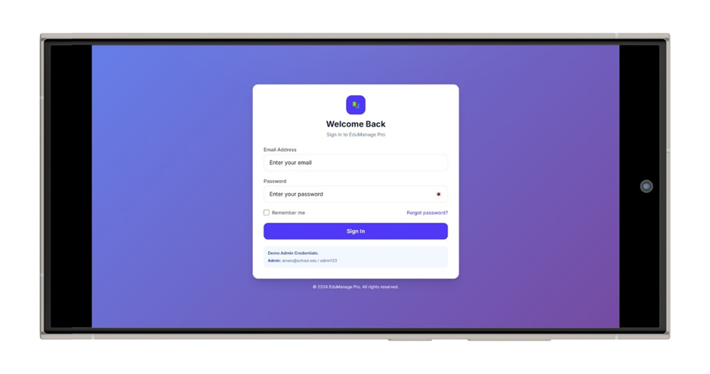
User Stories - Login/Register
Login/Register:
Student: Secure login to access classes and materials.
Teacher: Login to manage timetables and upload content.
Admin: Register and manage user accounts.
Dashboard:
Student: View upcoming classes and messages..
Teacher: See schedule and notifications.
Admin: Monitor overall system activity.

Slide 6
User Stories - Timetable & Materials
Timetable:
Student: View timetable to attend classes on time.
Teacher: Create/edit timetables.
Admin: Approve timetable changes.
Materials:
Teacher: Upload notes and resources.
Student: Download study materials.
Admin: Monitor content quality.

Slide 7
User Stories - Messaging & Notifications
Messaging:
Student: Message teachers for clarifications..
Teacher: Send updates to students..
Admin: Ensure proper use of messaging.
Notifications:
Student: Receive alerts for timetable changes.
Teacher: Notify students about assignments/events.
Admin: Send school-wide alerts.

Slide 8

AI Component
AI Features (Future Implementation)
Class Reminder Optimization → Analyzes timetables & user patterns to send timely reminders.
Material Suggestion → Recommends relevant notes/assignments based on lesson topics.
Message Prioritization → Detects keywords (e.g., urgent, assignment) to highlight important messages.
Technology
Implemented in Python backend.
Uses scikit-learn for classification & keyword analysis.
.

Slide 9

Database Design - Relational database in MySQL Workbench.
Entities and Key Attributes:
Users → user_id (PK), full_name, email, password_hash, role, date_created
Timetables → timetable_id (PK), user_id (FK), class_name, day_of_week, start_time, end_time
Materials → material_id (PK), uploaded_by (FK), title, file_path, upload_date, description
Notifications → notification_id (PK), sent_to (FK), message, date_sent
Messages → message_id (PK), sender_id (FK), receiver_id (FK), content, timestamp
Design Data
Relationships validated with sample data.
Schema supports authentication, scheduling, resource sharing, and communication.

Slide 10
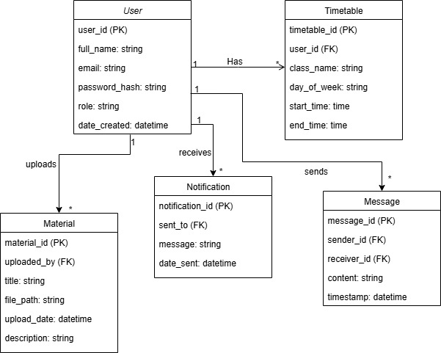
Class Diagram

Slide 11
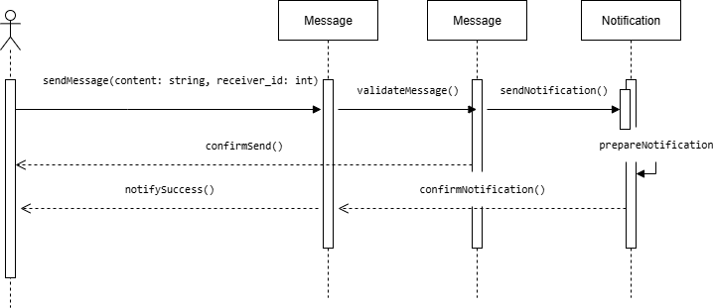
Sequence Diagram

Slide 12
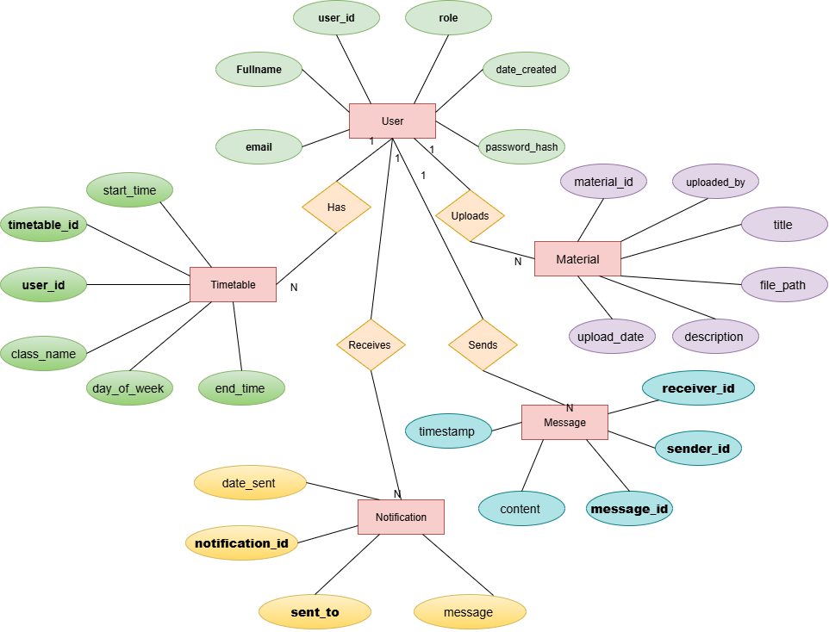
ER Diagram

Slide 13



Software Architecture - Three-Tier MVC Architecture: Data Flow: Frontend sends HTTPS API requests → Backend validates → Database processes → Response
Presentation Layer:
Application Layer:
Data Layer:
React Native (Android)
React Router, Axios
CSS / Material UI
Python FastAPI
Firebase Authentication
Firebase Cloud Messaging
MySQL on Oracle WorkBench
Encrypted data storage

Slide 14


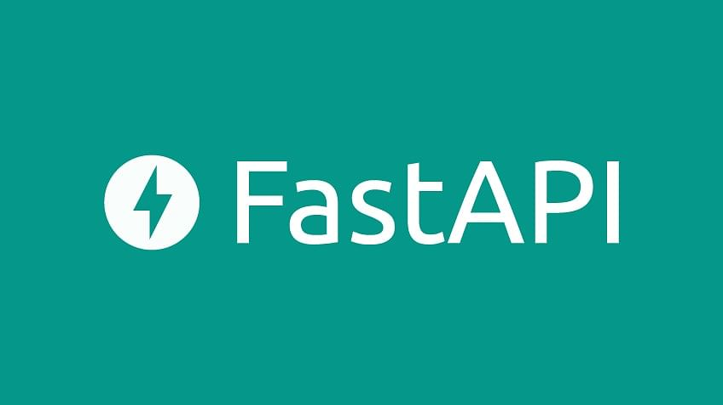

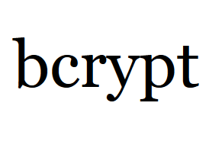


Platforms, Tools, and Frameworks
Frontend
Platform: Android (React Native)
Language: JavaScript (ES6)
Tools: React Native, React JS
Backend
Language: Python
Tools: FastAPI, scikit-learn, pip, bcrypt

Slide 15
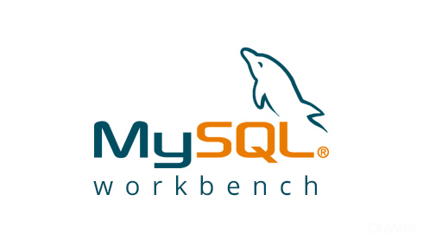



Platforms, Tools, and Frameworks
Database
Platform: MySQL Workbench
Language: SQL
Backend: Python
Development Setup
JDK / Android SDK
Android Studio/ Visual Studio

Slide 16

Test Results
Testing Types
Unit Testing → Validated individual components (login, file upload).
Regression Testing → Confirmed updates did not break existing features.
Functional Testing → Verified user actions (timetable view, message sending).
User Acceptance Testing (UAT) → Simulated real-world use cases with end-users.
Outcome
All tests successfully passed.
Evidence documented in Test Plan.xlsx.

Slide 17
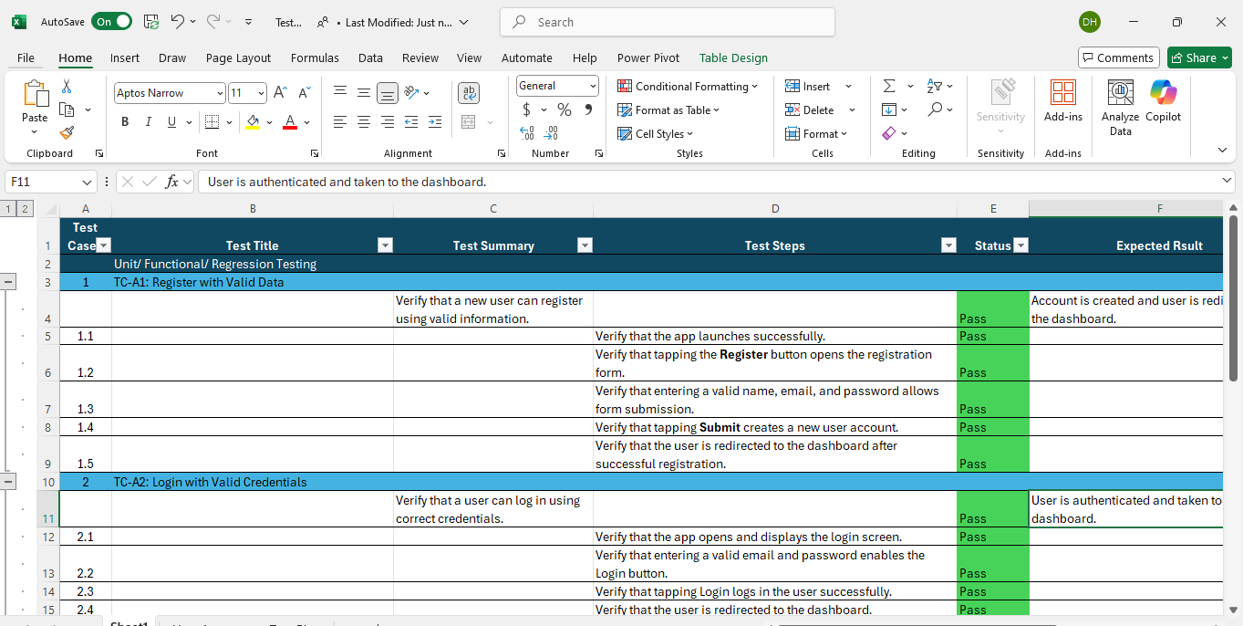
Unit Testing/ Regression Testing

Slide 18
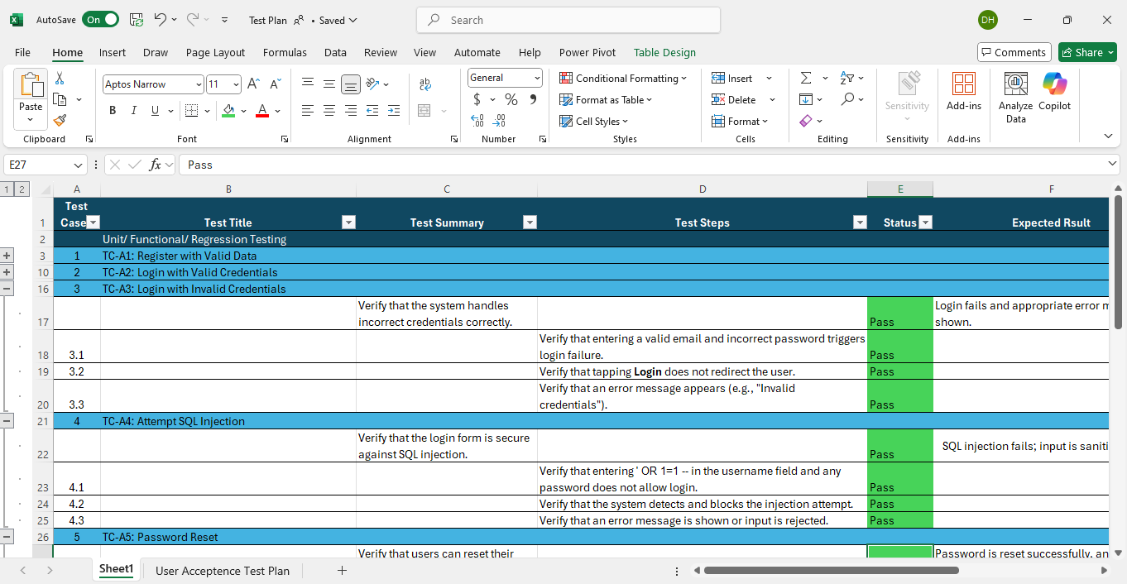
Unit Testing

Slide 19

Postman
Tool Used: Postman
Purpose: Validate backend APIs and data flow
Endpoints Tested:
Login & Authentication
Timetable retrieval
Material upload/download
Messaging & Notifications
Checks Performed:
Correct responses & status codes
Error handling validation
Response time performance
Result: All APIs returned expected outcomes successfully

Slide 20
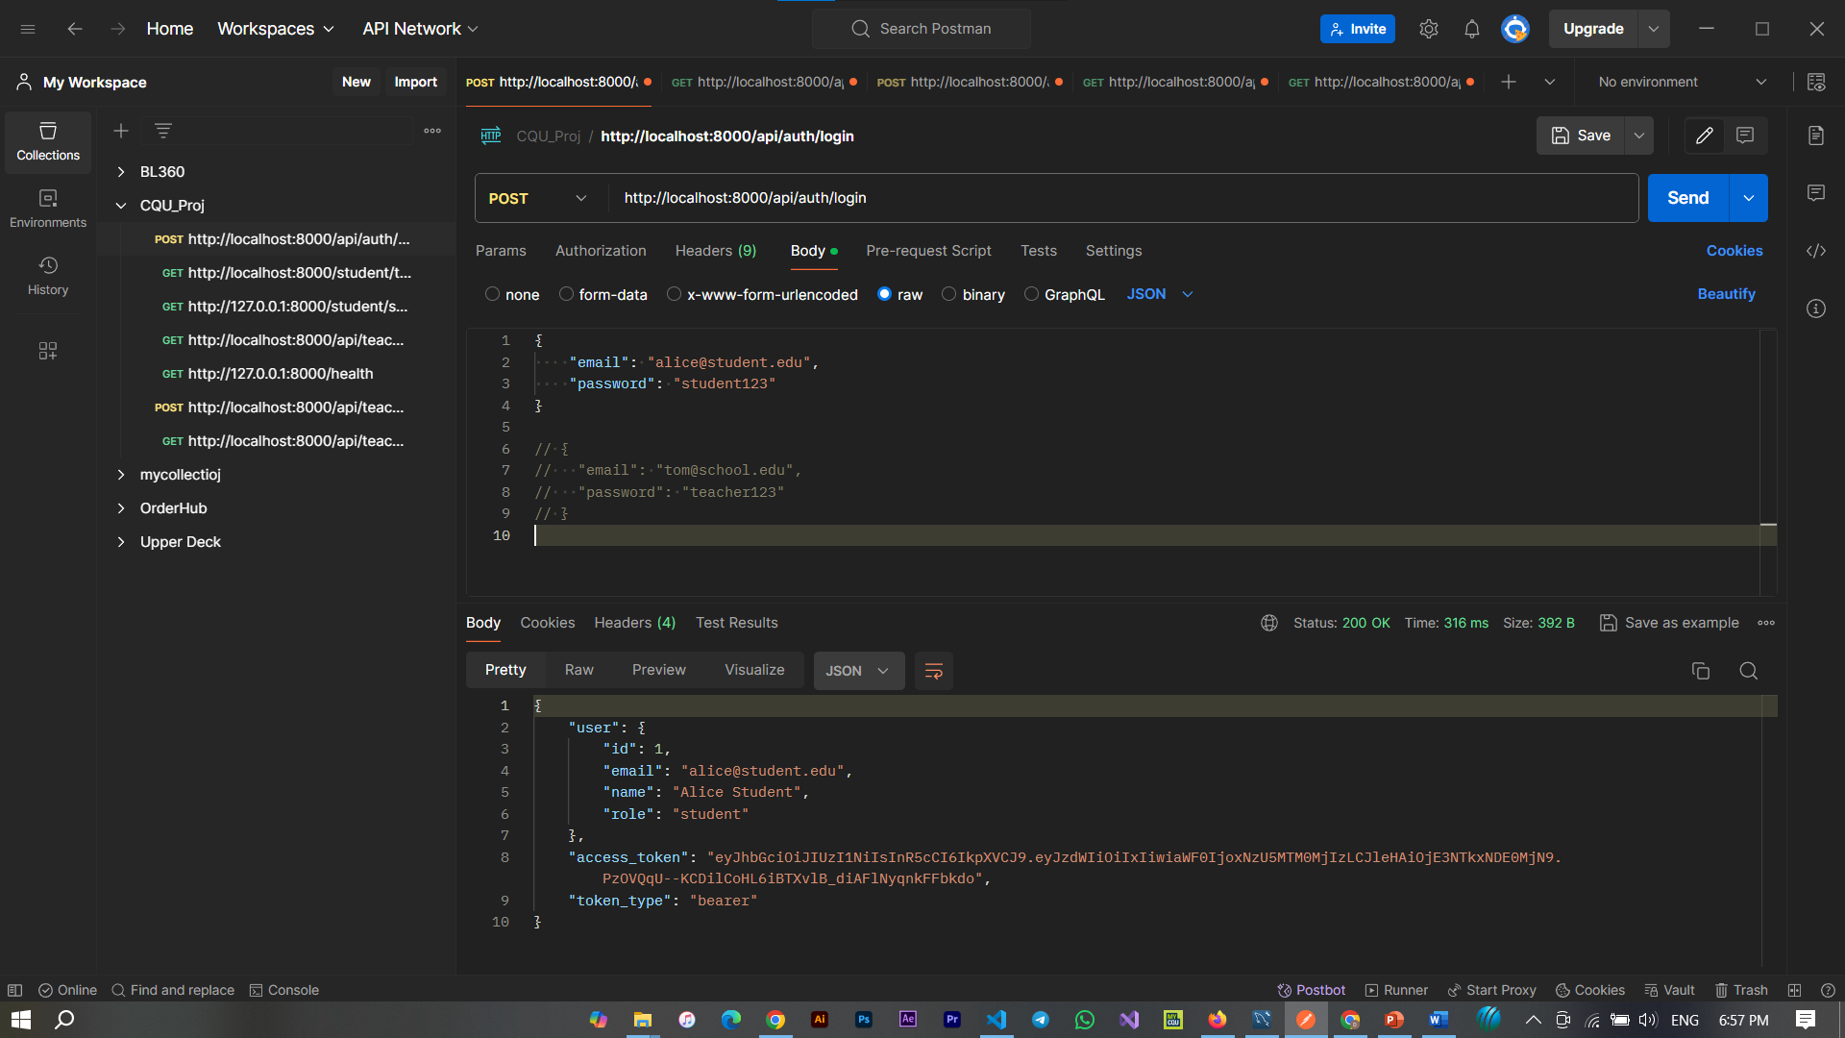
API Testing - Postman
POST request to /api/auth/login

Slide 21
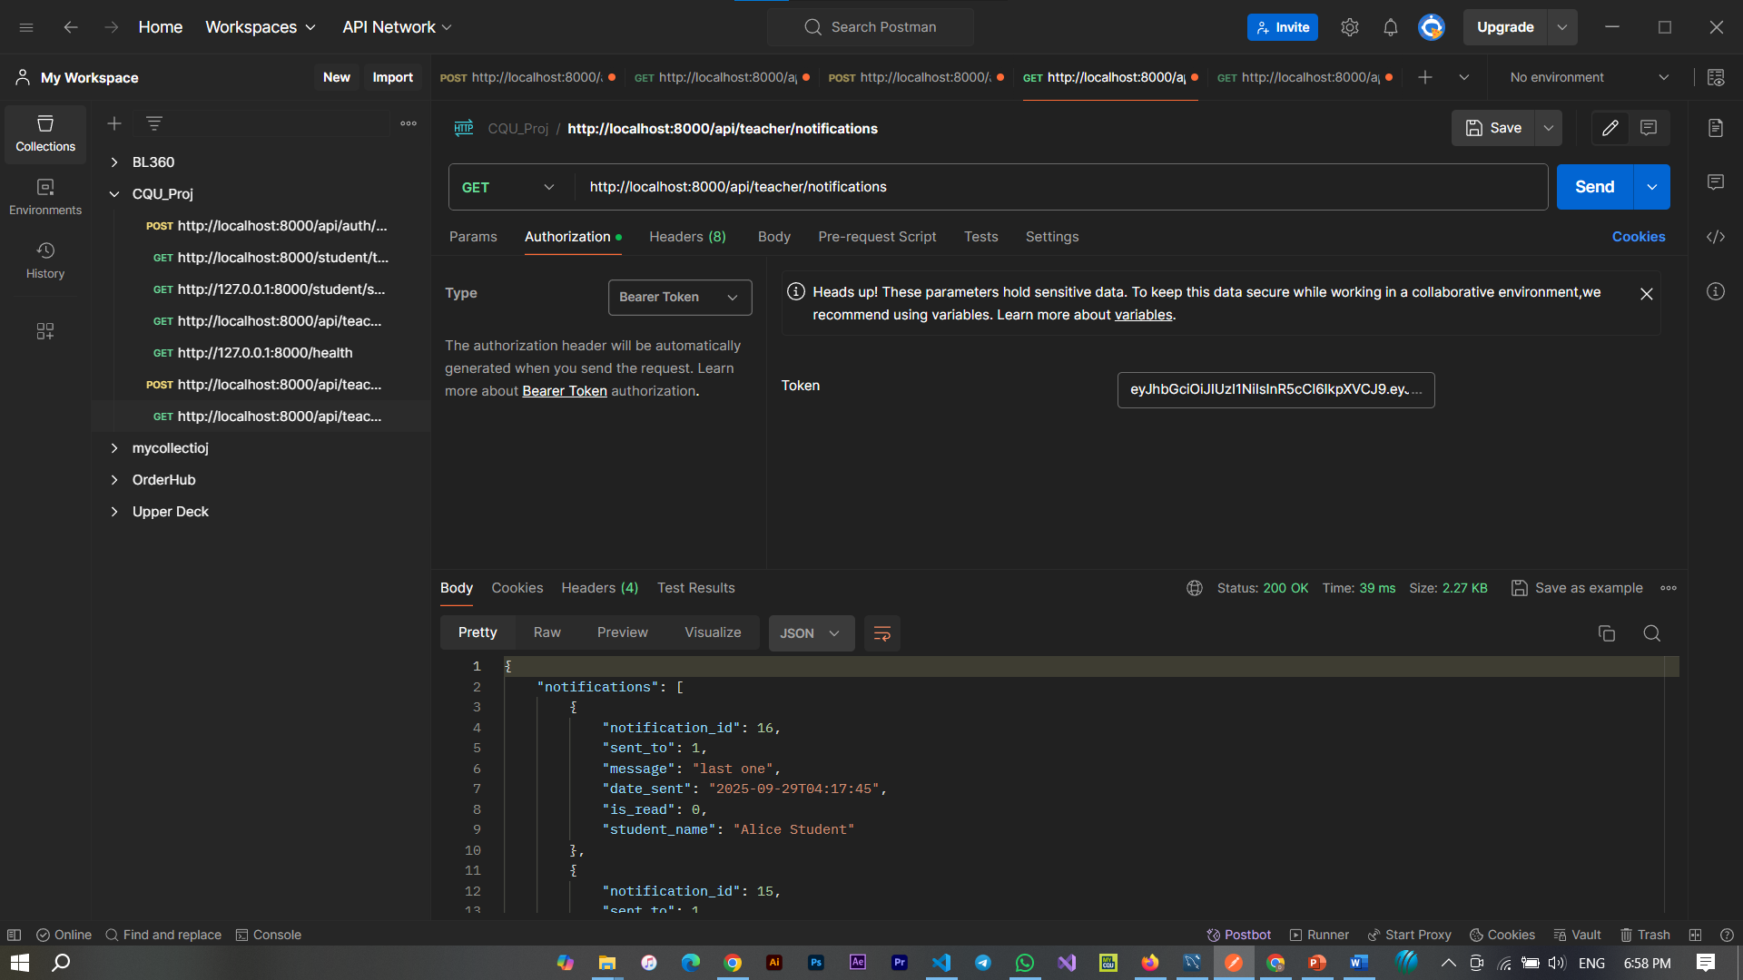
API Testing - Postman
GET request to /api/teacher/notifications

Slide 22
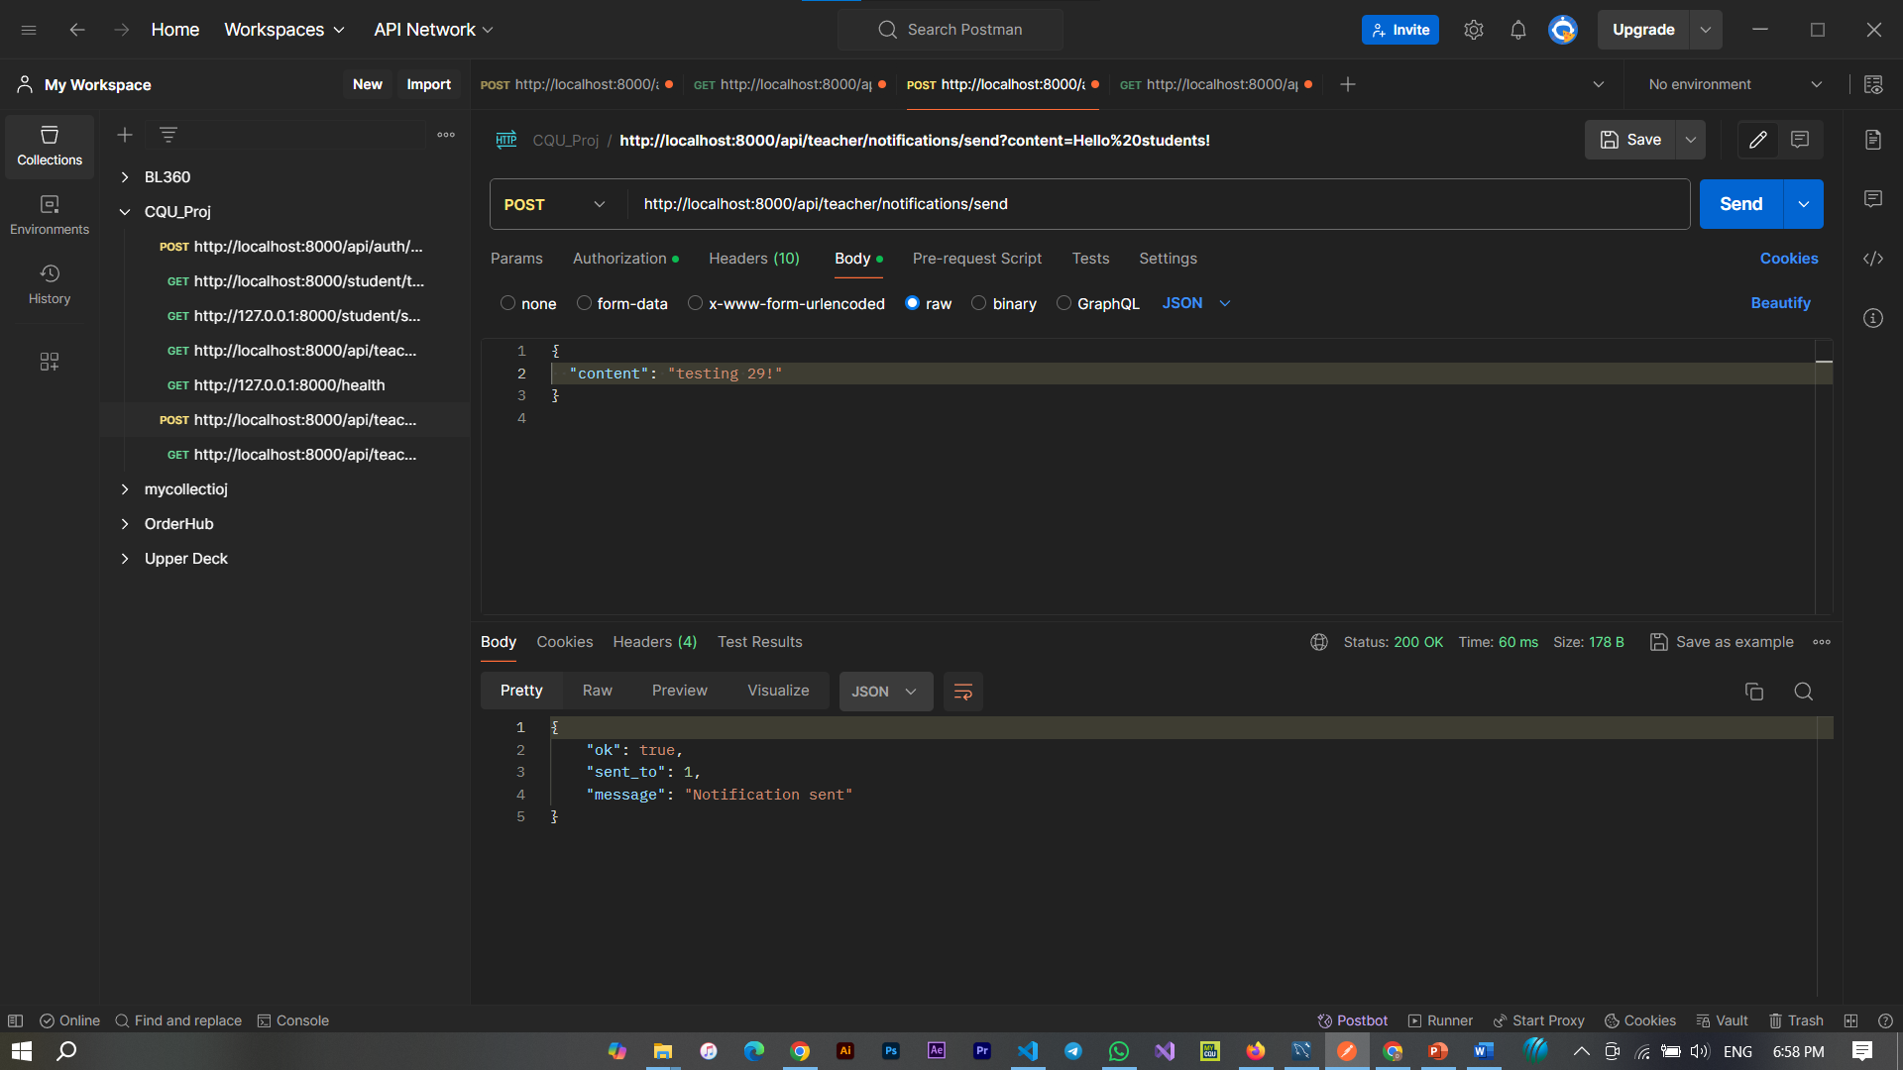
API Testing - Postman
POST request to /api/teacher/notifications/send

Slide 23
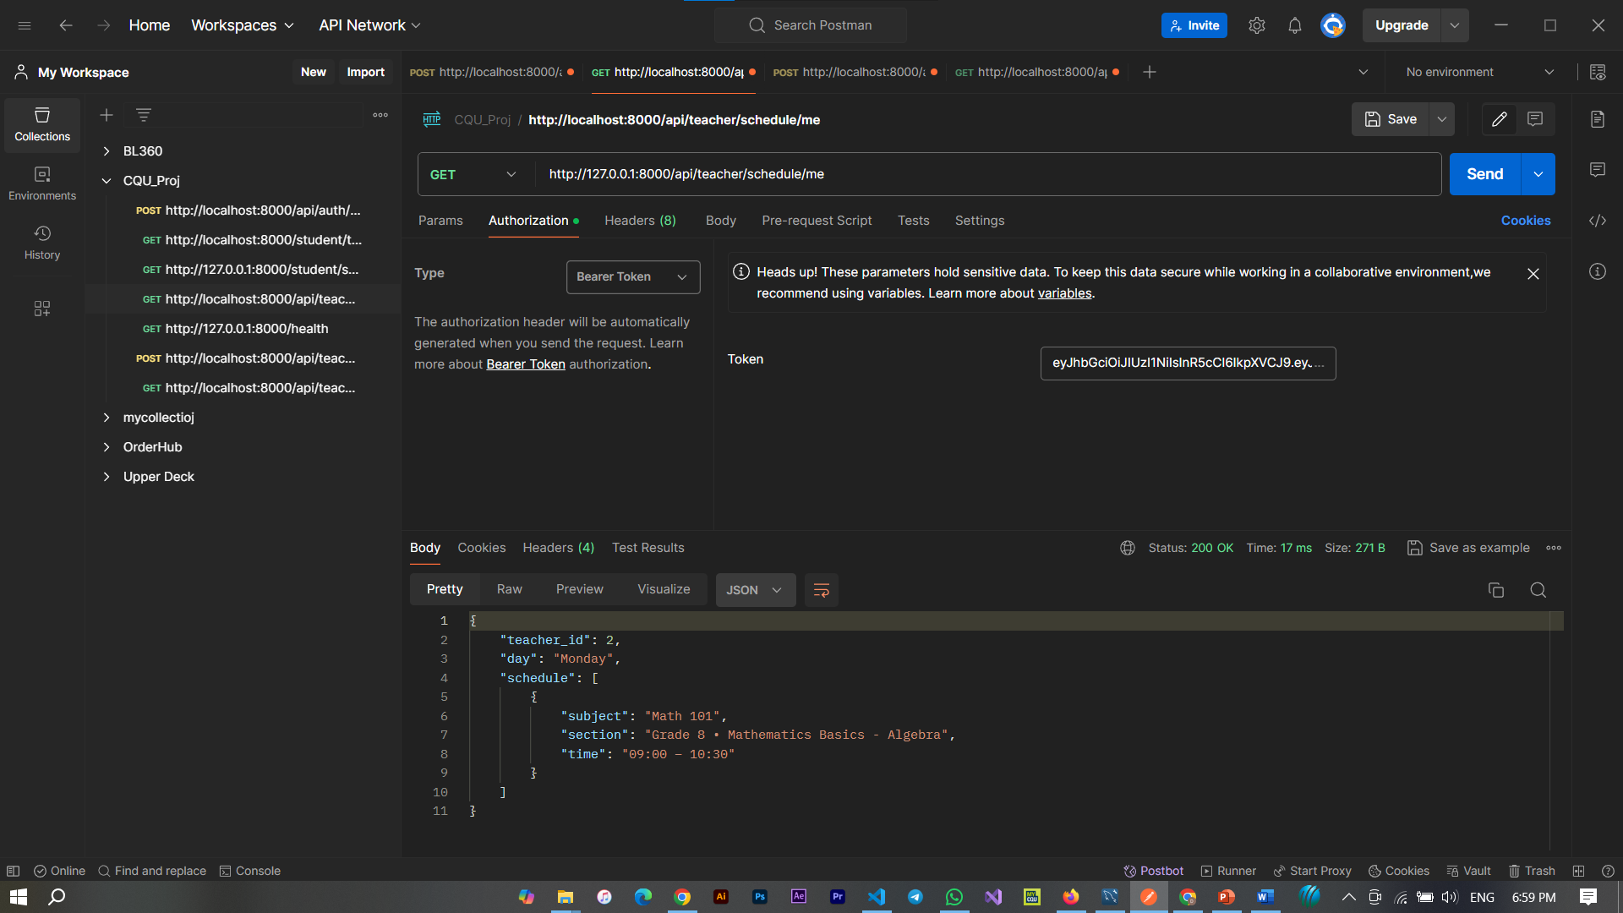
API Testing - Postman
GET request to /api/teacher/schedule/me

Slide 24

User Manual
User Manual (For End Users)
Login → Enter email & password; role-based dashboard loads
Timetable → Students view, teachers create/edit, admins approve
Materials → Teacher's upload, students download, admins monitor
Messaging & Notifications → Send/receive messages, view alerts
AI Features → Chat bot and sending the timetable notification to students.

Slide 25

System Manual
System Manual (For Developers/Admins)
Installation → Install Android Studio, MySQL; run python FastAPI backend
Configuration → Set database connections
Maintenance → Monitor logs, update dependencies
Troubleshooting → Handle common issues (auth errors, API failures)

Slide 26

Project Tracking - Jira
Purpose
Task assignment and progress monitoring
Supports agile sprints, issue tracking, and workflows
Evidence
Visual tracking of tasks: To Do → In Progress → Testing → Done

Slide 27
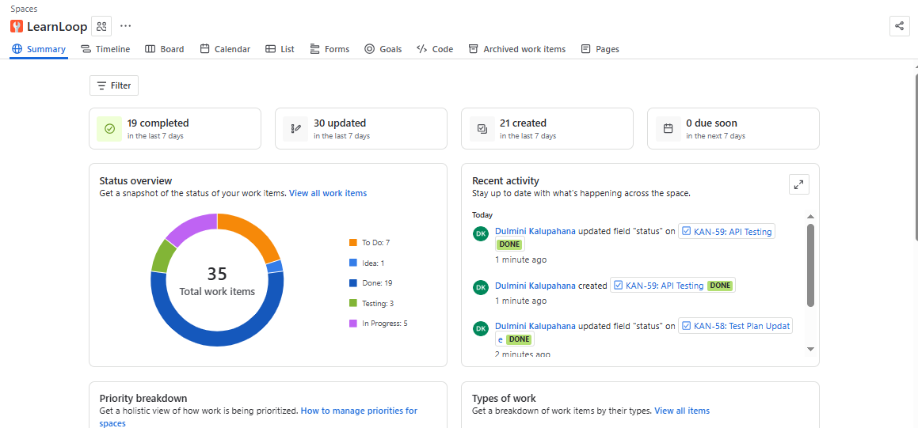
Project Tracking - Jira

Slide 28
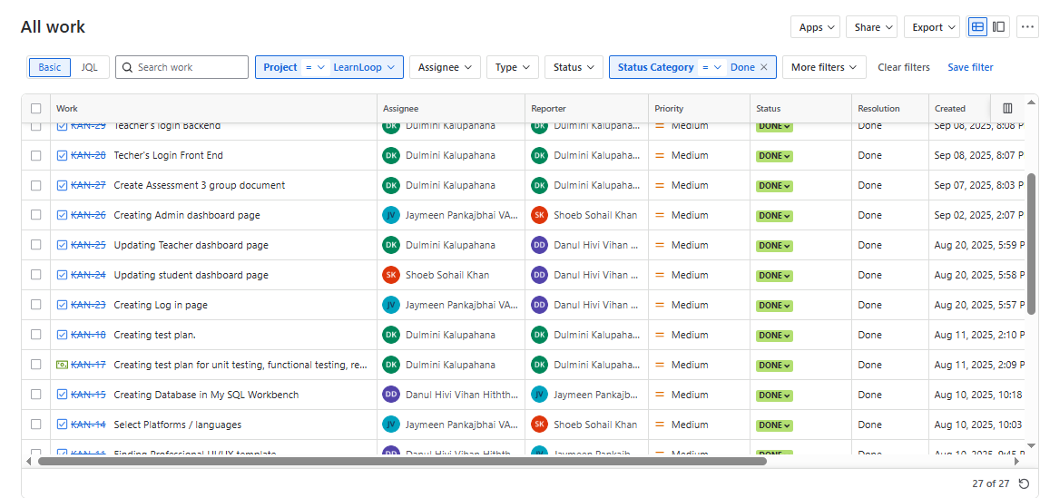
Project Tracking - Jira

Slide 29
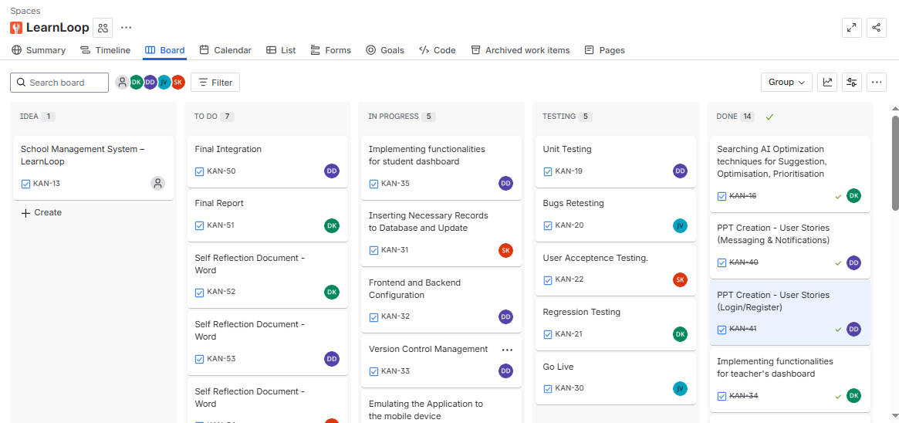
Project Tracking - Jira

Slide 30
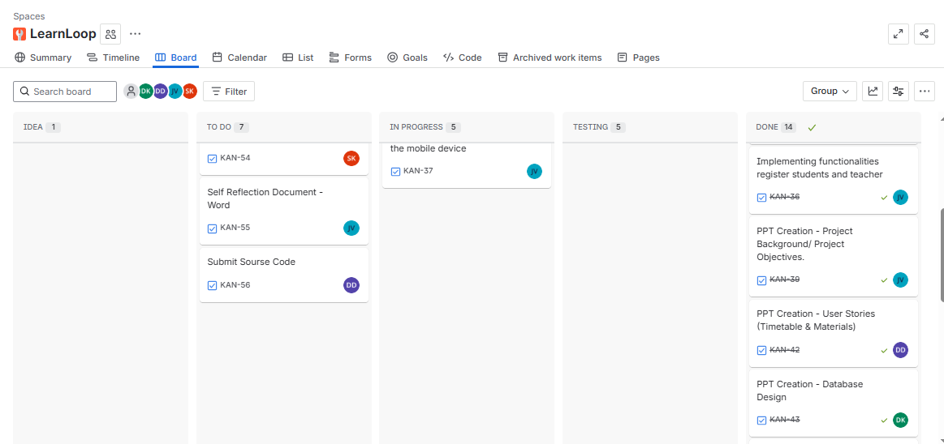
Project Tracking - Jira

Slide 31
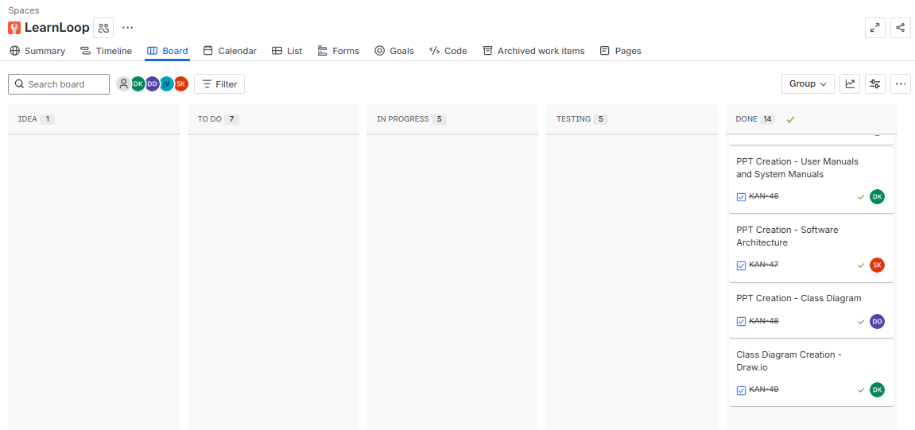
Project Tracking - Jira

Slide 32

Version Control - GitHub
Repository : LearnLoop
Regular commits for:
Code updates
Database schema
UI mockups

Slide 33
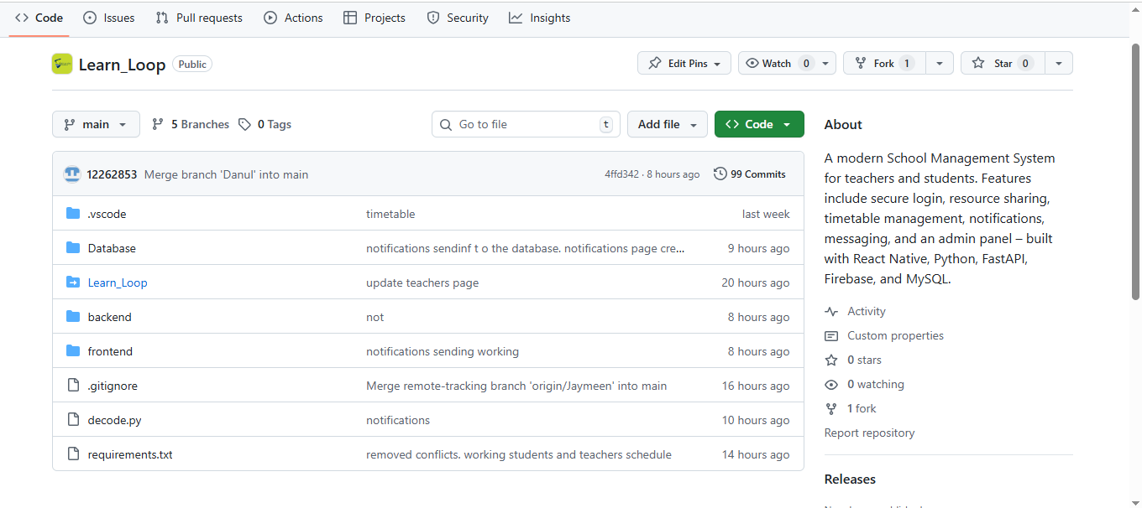
Version Control - GitHub

Slide 34
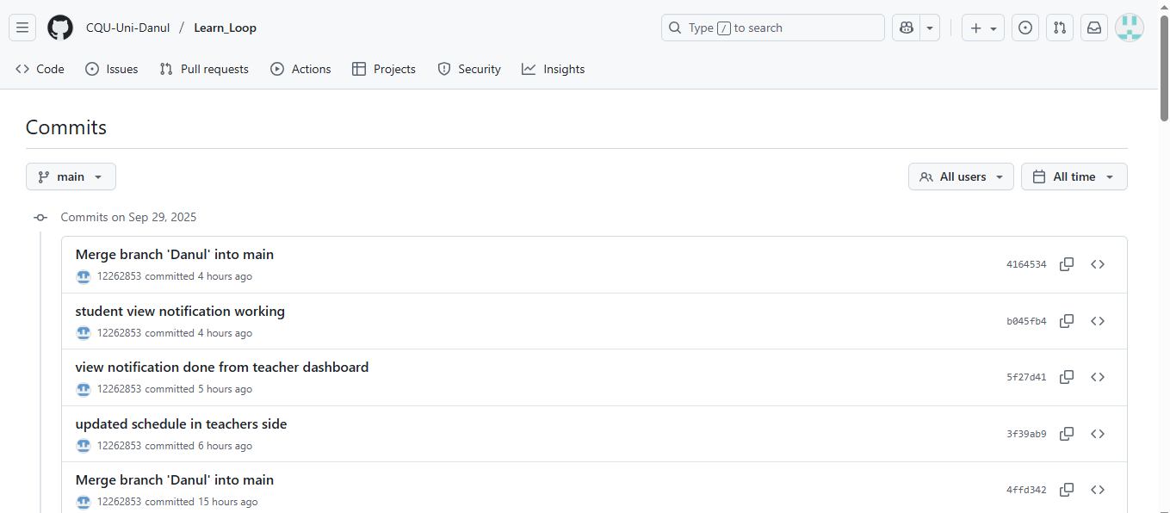
Version Control - GitHub

Slide 35
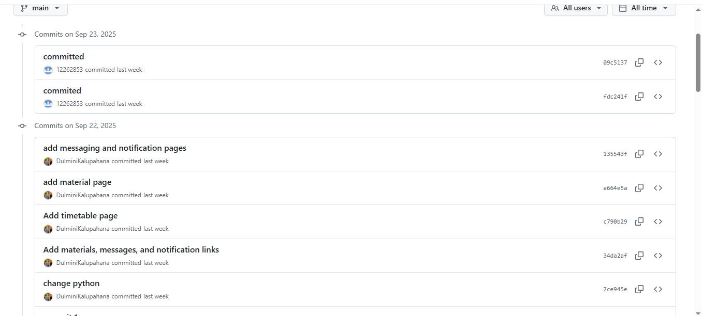
Version Control - GitHub

Slide 36
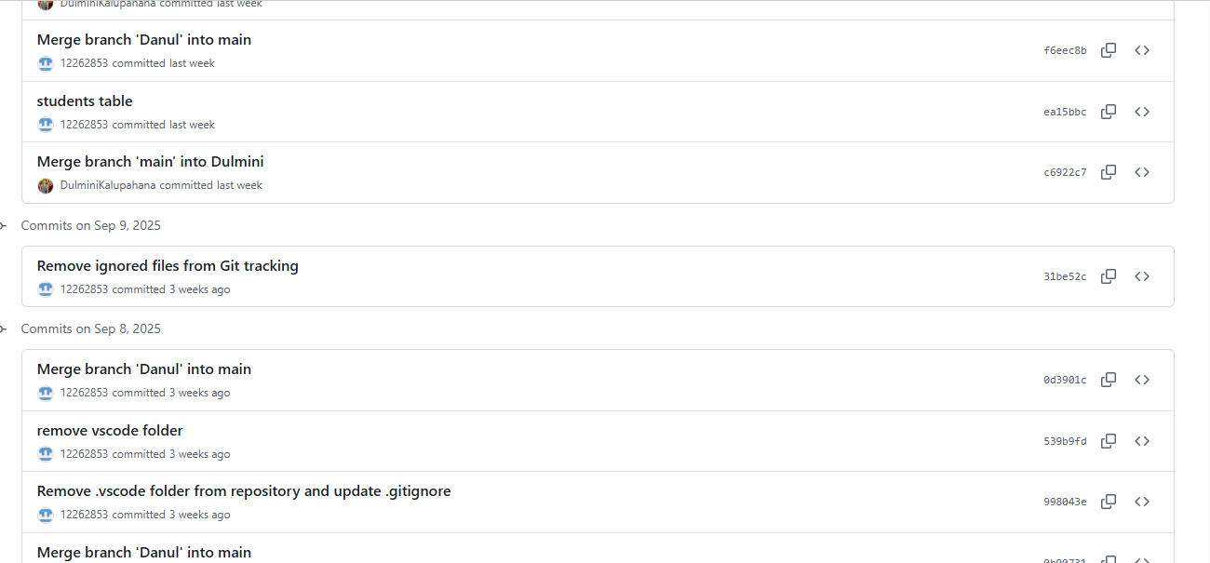
Version Control - GitHub

Slide 37
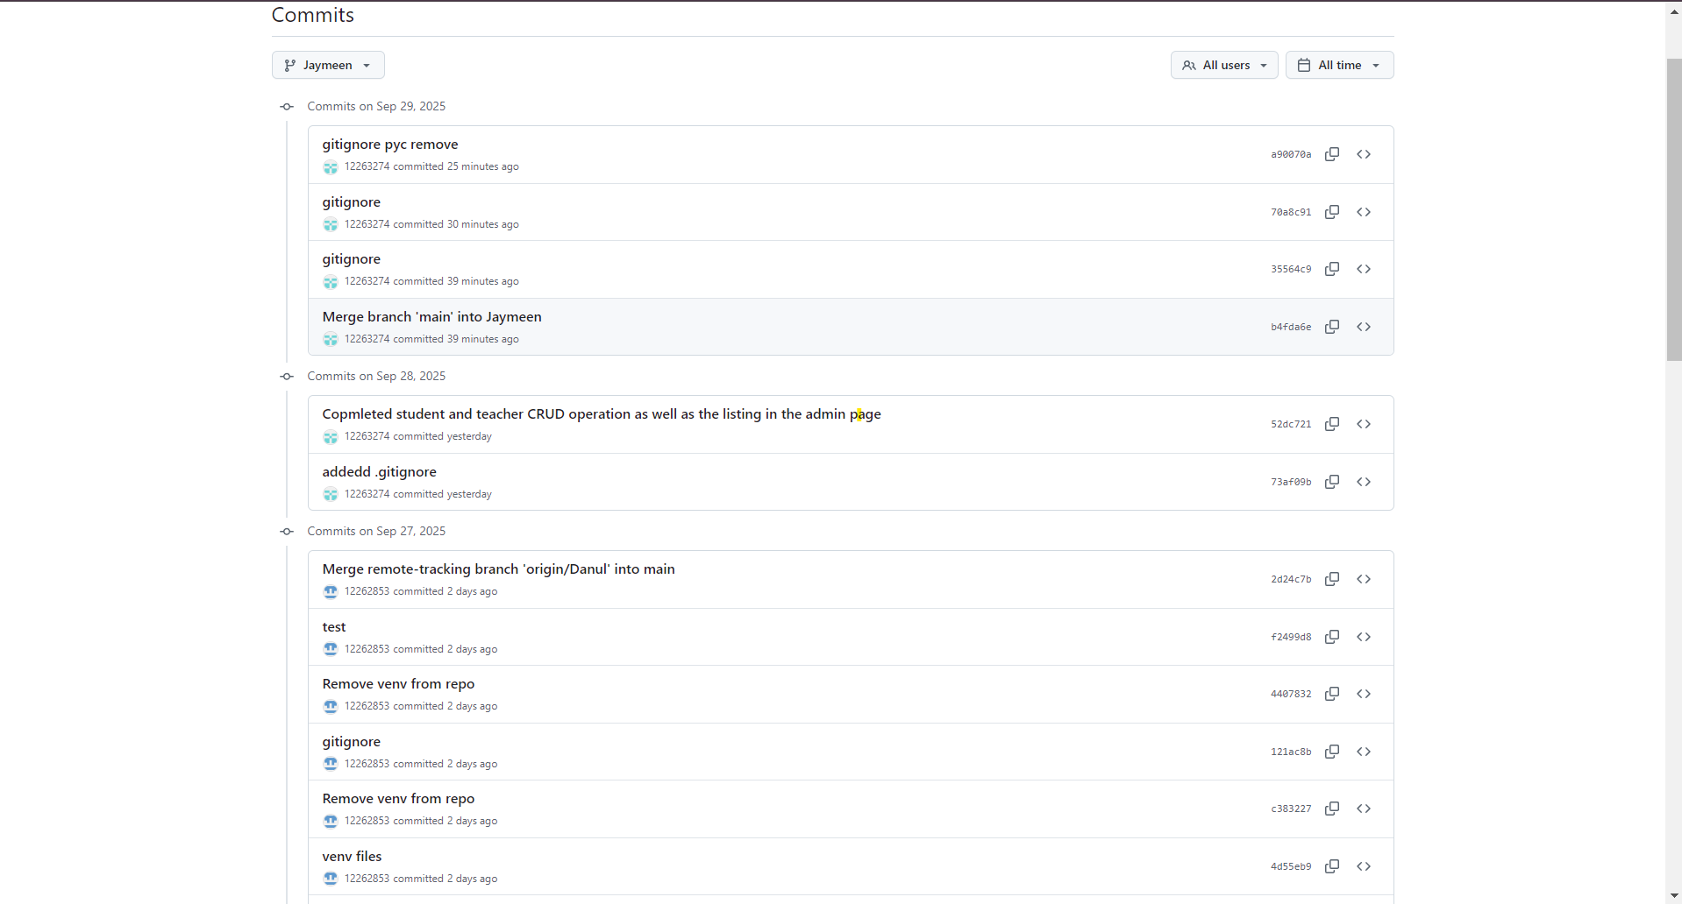

Slide 38
Conclusion
Successfully designed and prototyped a Smart School Management System
Implemented all user stories with role-based functionality
Integrated AI for intelligent notifications & Chat bot.
Validated system through testing, tracked progress via Jira & GitHub
Future Steps → Full deployment, enhanced AI, and additional features

Slide 39

Thank you
Any questions?

